Slide 1
Logic Gates

Slide 2
Transistors and Logic Gates
Modern computers use binary code to represent all information (1s or 0s)
The 1s or 0s in a computer are the presence, or lack of, electric signals.
Inside a computer, the device that is responsible for manipulating the binary data (electric ON or OFF signals) is called a TRANSISTOR .
If a transistor is ON; electrical current flows through. If it is OFF, current does not flow through.
Transistors can be arranged in different ways to carry out Boolean Logic Operations. These arrangements are known as LOGIC GATES .

Slide 3
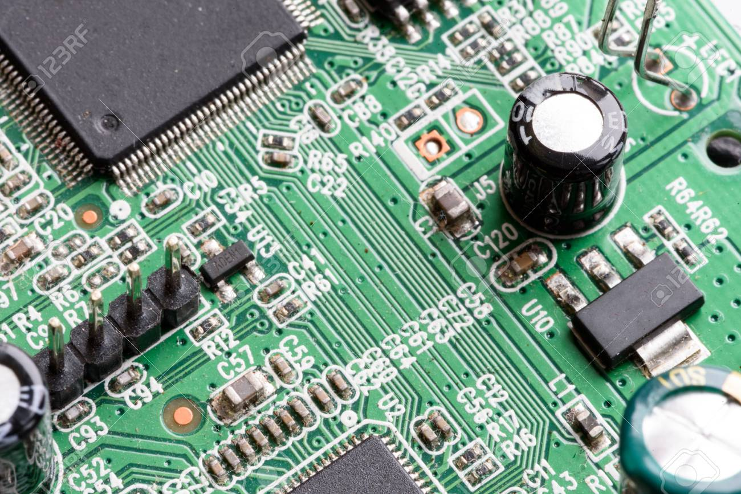
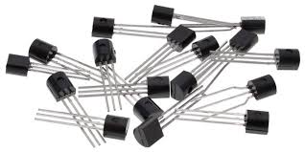
Transistors
Transistor, semiconductor device for amplifying, controlling, and generating electrical signals. Transistors are the active components of integrated circuits, or “microchips,” which often contain billions of these minuscule devices etched into their shiny surfaces

Slide 4
Logic Gates
Logic Gates allow a computer to carry out Boolean Operations on binary code by controlling the flow of electricity represented by 1s and 0s in different ways
The Central Processing Unit (CPU) of a computer is the electronic circuitry within a computer that executes instructions that make up a computer program. The CPU performs basic arithmetic, logic, controlling, and input/output (I/O) operations specified by the instructions in the program.
A CPU is largely made up of lots of combinations of logic gates (each logic gate is made up of transistors).
Source: Becker B. & Quille K, Computer Science for Leaving Cert
Notes:
CPU contrasts with external components such as main memory and I/O circuitry,[1] and specialized processors such as graphics processing units (GPUs).

Slide 5
Logic Gates
Logic Gates are made up of transistors.
Computers process binary data using Logic Gates.
Logic Gates take in more than one input and give one output.
Five types that you need to know:
and, or, not, nand, nor

Slide 6
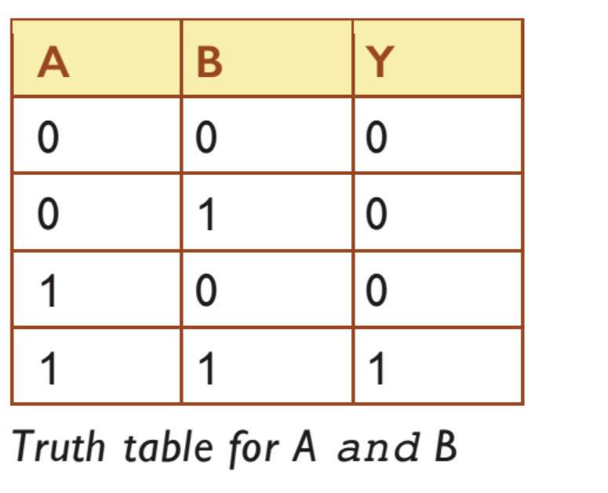
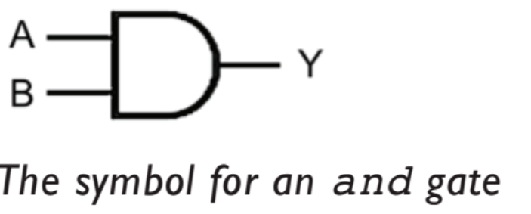
and gate
Truth Table Logic Gate

Slide 7
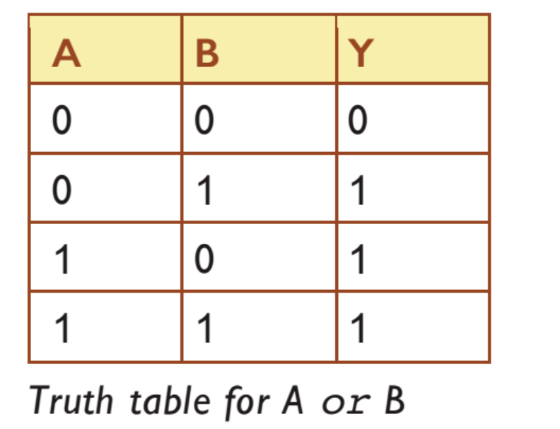
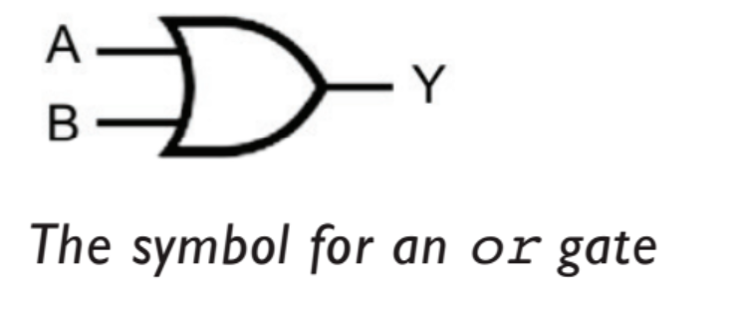
or gate
Truth Table Logic Gate

Slide 8
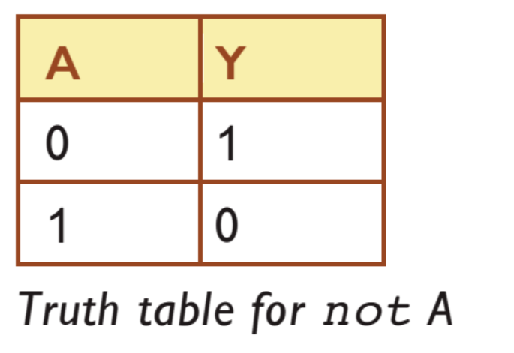
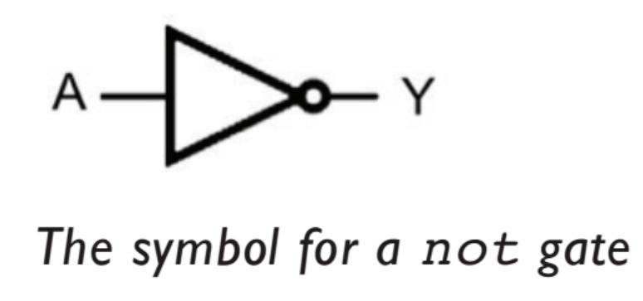
not gate
Truth Table Logic Gate

Slide 9
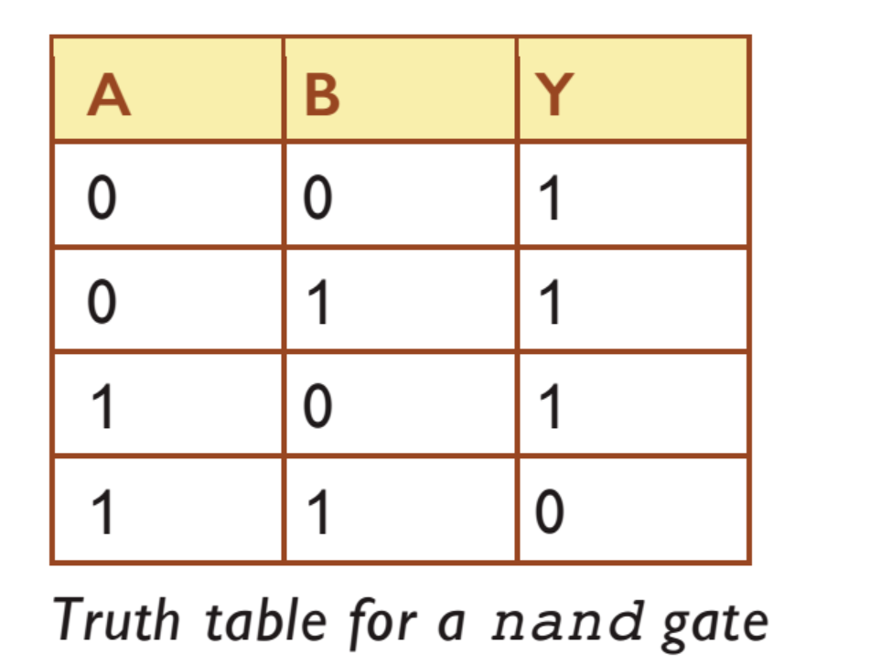
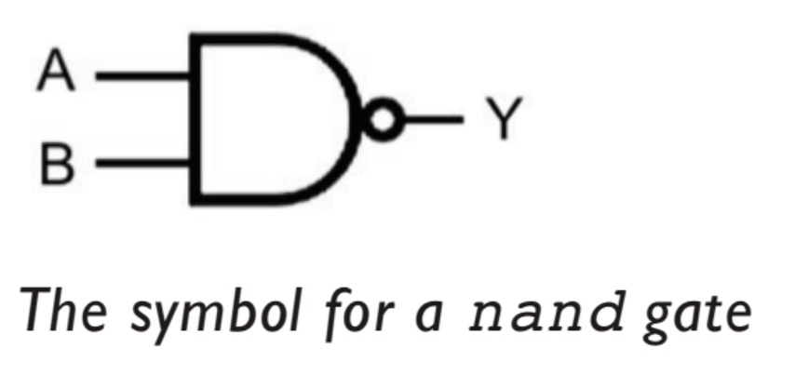
nand gate
Truth Table Logic Gate

Slide 10
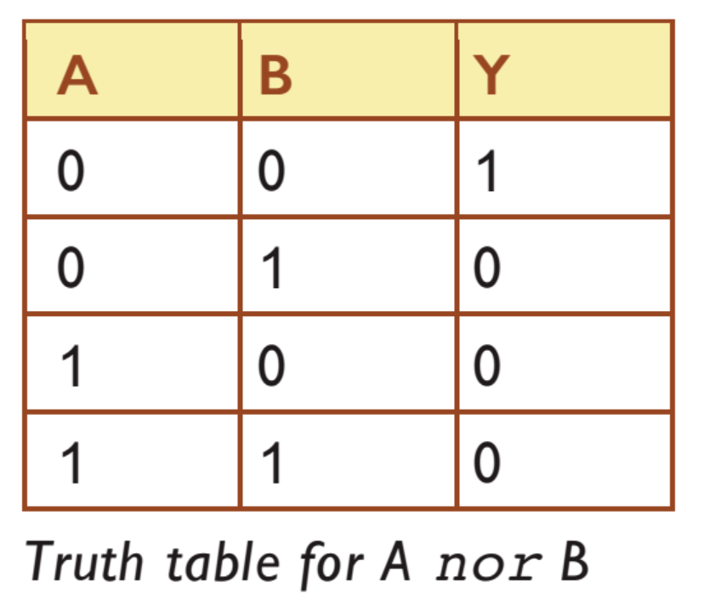
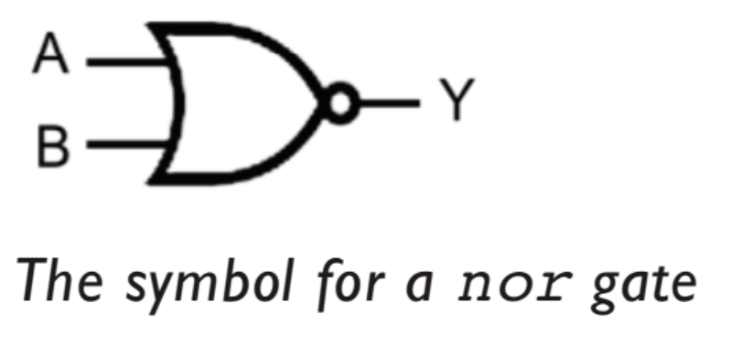
nor gate
Truth Table Logic Gate

Slide 11
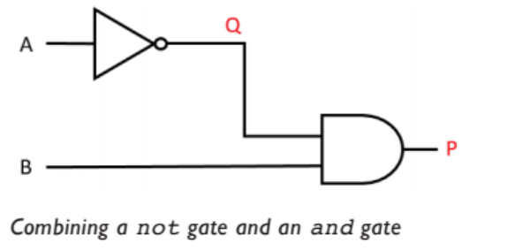
Combining Logic Gates

Slide 12
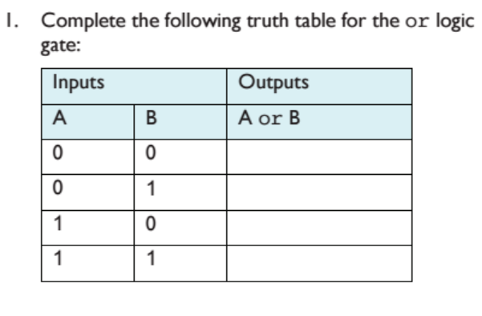
Questions

Slide 13
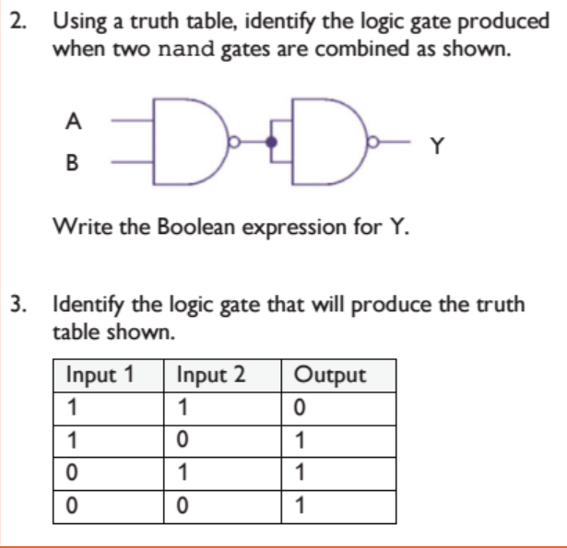

Slide 14
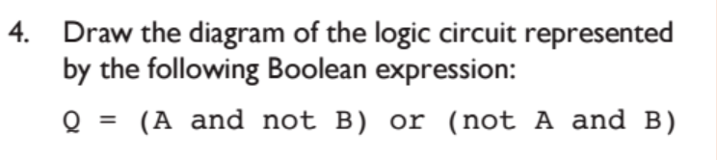

Slide 15
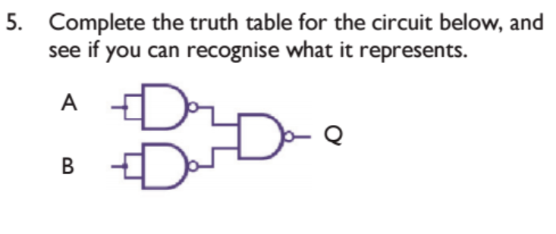

Slide 16
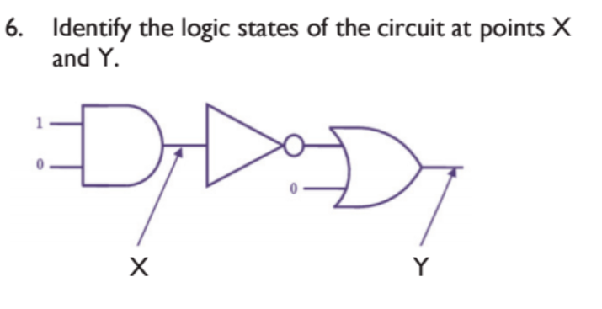

Slide 17
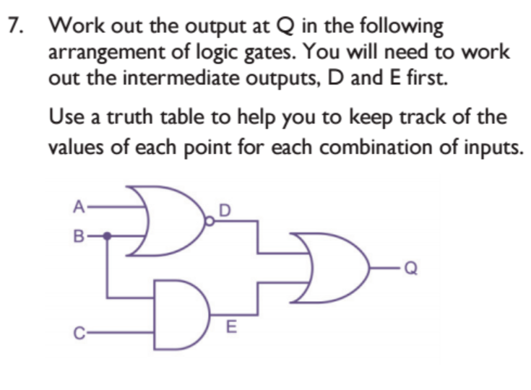

Slide 18
